Slide 1
CLASSIFICATION OF MAGNETIC MATERIALS

Slide 2
The magnetic materials are generally classified into three types based on the behavior of materials in a magnetizing field. They are
Diamagnetic materials
Paramagnetic materials
Ferromagnetic materials

Slide 3
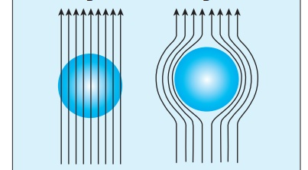
Diamagnetic materials
When placed in a non-uniform magnetic field material moves from stronger part to weaker part of the external field. It means that diamagnetic material is repelled by the field.
Examples: Bismuth, Copper and Water etc.

Slide 4
Cause of diamagnetic Behavior
The orbital motion of electrons around the nucleus produces a magnetic field perpendicular to the plane of the orbit .The vector sum of magnetic moments is zero and there is no resultant magnetic moment for each atom.
In the presence of an external magnetic field, some electrons are speeded up and some are slowed down. The electrons whose magnetic dipole moments were anti-parallel are speeded up to produce an induced magnetic moment in a direction opposite to the field.

Slide 5
The properties of diamagnetic materials
Relative permeability is slightly less than unity.
Magnetic susceptibility is negative.
The magnetic field lines are repelled .
Susceptibility is nearly temperature independent.

Slide 6
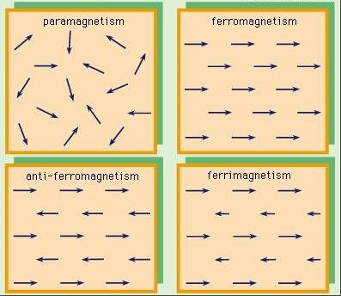
Paramagnetic Materials
When placed in a non-uniform magnetic field, the paramagnetic materials have a tendency to move from weaker to stronger part of the field. Examples: Aluminium, Platinum and chromium etc.

Slide 7
Cause of Paramagnetic Behavior
In these magnetic materials, each atom or molecule has net magnetic dipole moment which is the vector sum of orbital and spin magnetic moments of electrons. Due to the random orientation of these magnetic moments, the net magnetic moment of the materials is zero.
In the presence of an external magnetic field, the torque acting on the atomic dipoles align them in the field direction. As a result, there is net magnetic dipole moment induced in the direction of the applied field. The induced dipole moment is present as long as the external field exists.

Slide 8
Properties of paramagnetic materials
Magnetic susceptibility is positive and small.
Relative permeability is greater than unity.
The magnetic field lines are attracted
when placed in a magnetic field.
Susceptibility is inversely proportional to temperature.

Slide 9
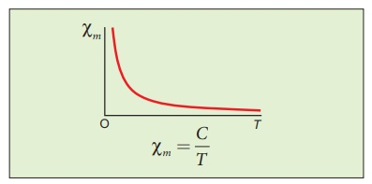
Curie’s law
When temperature is increased, thermal vibration will upset the alignment of magnetic dipole moments. Therefore, the magnetic susceptibility decreases with increase in temperature.

Slide 10
Ferromagnetic materials
Materials that are Strongly attracted by applied external magnetic field
Examples: Iron, Nickel and Cobalt

Slide 11
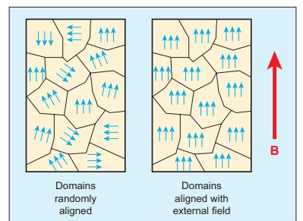
Cause of Ferromagnetic Behavior
Atom in a ferromagnetic material possesses net magnetic dipole moment. These materials have domains. In each domain the magnetic moments are aligned in a direction by strong electron- spin interactions. The net magnetization of the specimen is zero as domains are independently oriented.
When put in external magnetic field, domains align in direction of applied field.

Slide 12
The properties of ferromagnetic materials
Magnetic susceptibility is positive and large.
Relative permeability is large.
The magnetic field lines are strongly attracted into the ferromagnetic materials.
Susceptibility is inversely proportional to temperature.

